Slide 1
Virtualized Security Chains
John Studarus
john@jhlconsulting.com
JOHN@OPENSTACKSANDIEGO.ORG
@JOHN_STUDARUS

Slide 2
Agenda
What’s hard about cloud/virtual cyber-security?
And how can we fix it?
Cloud Networking/SDN Course
Technology options for service insertion and chaining
Virtualized Security Functions
What can we and how do we virtualize them?
Online Lab
See it all in action
https://github.com/OpenStackSanDiego/ServiceChains
What’s next?

Slide 3
Securing Virtualized Workloads Why so tough?
Dynamic lifetimes
Config Complexity
Security at the Edge
VM have short lifecycles
Containers are shorter!
Gone before security in place…
Solutions
Automate VM detection
Automate VM classification
Automate sec deployment
Dynamic licensing ($)
Rules based security controls
Different security configs
High staff workload to configure
Error prone one-off configs
Changes to layer 3 networking
Differing app workloads
Solutions
Standard configs per control
Prebuilt VMs ready to deploy
Layer 2 Injection
Bundled Offerings
Service Chaining
Crunchy on the outside…
…soft in the middle.
“Bolt on” security at edge
No monitoring within the cloud
Solutions
Deploy security within cloud
Protect N/S + E/W traffic
Compartmentalized security
Per tenant security controls

Slide 4
What is Service Chaining (SC)?
Capability to connect multiple network services to manipulate traffic through the chain.
Deep Packet Inspection
Firewall
Network Address Translation (NAT)
Load Balancer
Monitoring and analytics probes
“Lawful” Interception
Parental Controls
WAN/TCP Optimizer
Video Optimizer
Content Filtering/Caching

Slide 5
What is Virtual Network Function (NFV)?
Replacing a physical server/appliance that provided network services with a virtual machine/container or within the cloud management layer
Routing
Switching
DHCP
Network Logging
Network Address Translation (NAT)
Floating IPs
Virtual Private Network (VPN)
Network Visualization

Slide 6
Layer 2 versus Layer 3 Service Chain Why should we do this in layer 2?
Layer 2
Layer 3
Virtual port assignments
Lower latency
Can filter by IP & TCP/UDP port
Requires SDN support
Invisible to layer 3
Transparent to O.S./Applications
Swap w/o changes to workloads
IP address assignments
Additional network overhead
No layer 2 filtering
No special SDN support required
Visible to layer 3 probes
Invisible to O.S./Applications
Changes required workload reconfig

Slide 7
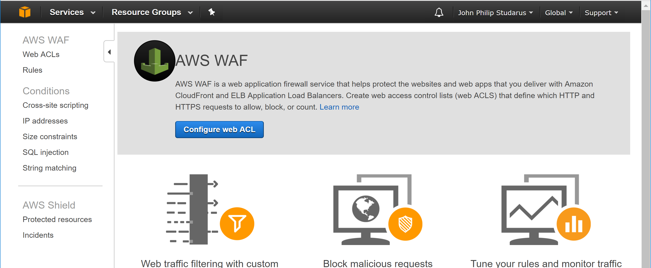
Welcome to the Walled Garden - WAF in Amazon Web Services
Transparent deployment – no layer 3 changes required
Rapid provisioning – self service and instantaneous
Consumption pricing - $5 per ACL + $1 per rule/month + $0.60/million requests
WAF is “Injected” in front of the application load balancer or CloudFront (CDN)
But what if I want to “Do It Yourself”?

Slide 8
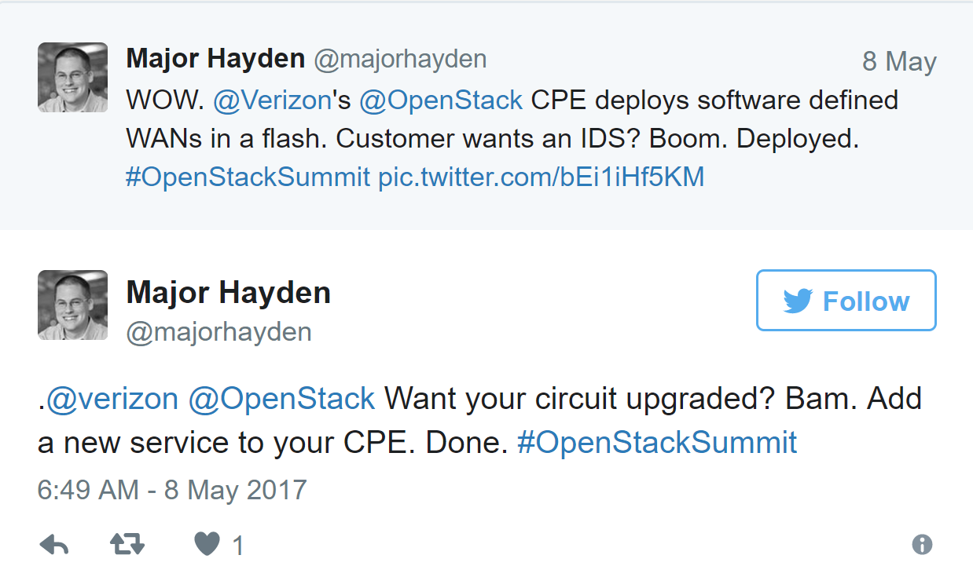
Why OpenStack? Preferred Open Source Private Cloud Solution
AT&T
Integrated Cloud (AIC) 80-100 zones
Verizon
Network Function Virtualization OpenStack cloud deployment
Edge Computing “Cloud in a Box” CPE rollout
Walmart
213,000 cores on OpenStack
GoDaddy
57 million domains & 8.5 million websites on OpenStack
PayPal
100% OpenStack Cloud – replaced VMWare
Corporate migrations from VMWare

Slide 9
OpenStack Neutron Network as a Service
Defined API
Implementations
Plugins
Add/Modify/Delete
Networks
Subnets
Ports (virtual interface)
Implement the Neutron API
Stock “Neutron”
Midonet
Plumgrid
Adds functionality to stock Neutron
LBaaS
ML2 (hardware support)
FWaaS
VPNaaS
OneConvergence (Service Chain)
Networking-sc (Service Chain)
API Used by…
Underlying SDN
Open vSwitch (OVS)
Linux Bridge
Nova (Compute)
Horizon (GUI)
CLI
HEAT (Templated Deployments)

Slide 10



Which security functions can I virtualize?
DHCP
Firewall {pfSense}
Anti-DDoS
WAF {modSecurity}
Web Proxy/Filter {squidGuard}
Bot Detection
Database Firewall
IDS/IPS {Snort}
VPN
Tap {TCPDump}

Slide 11
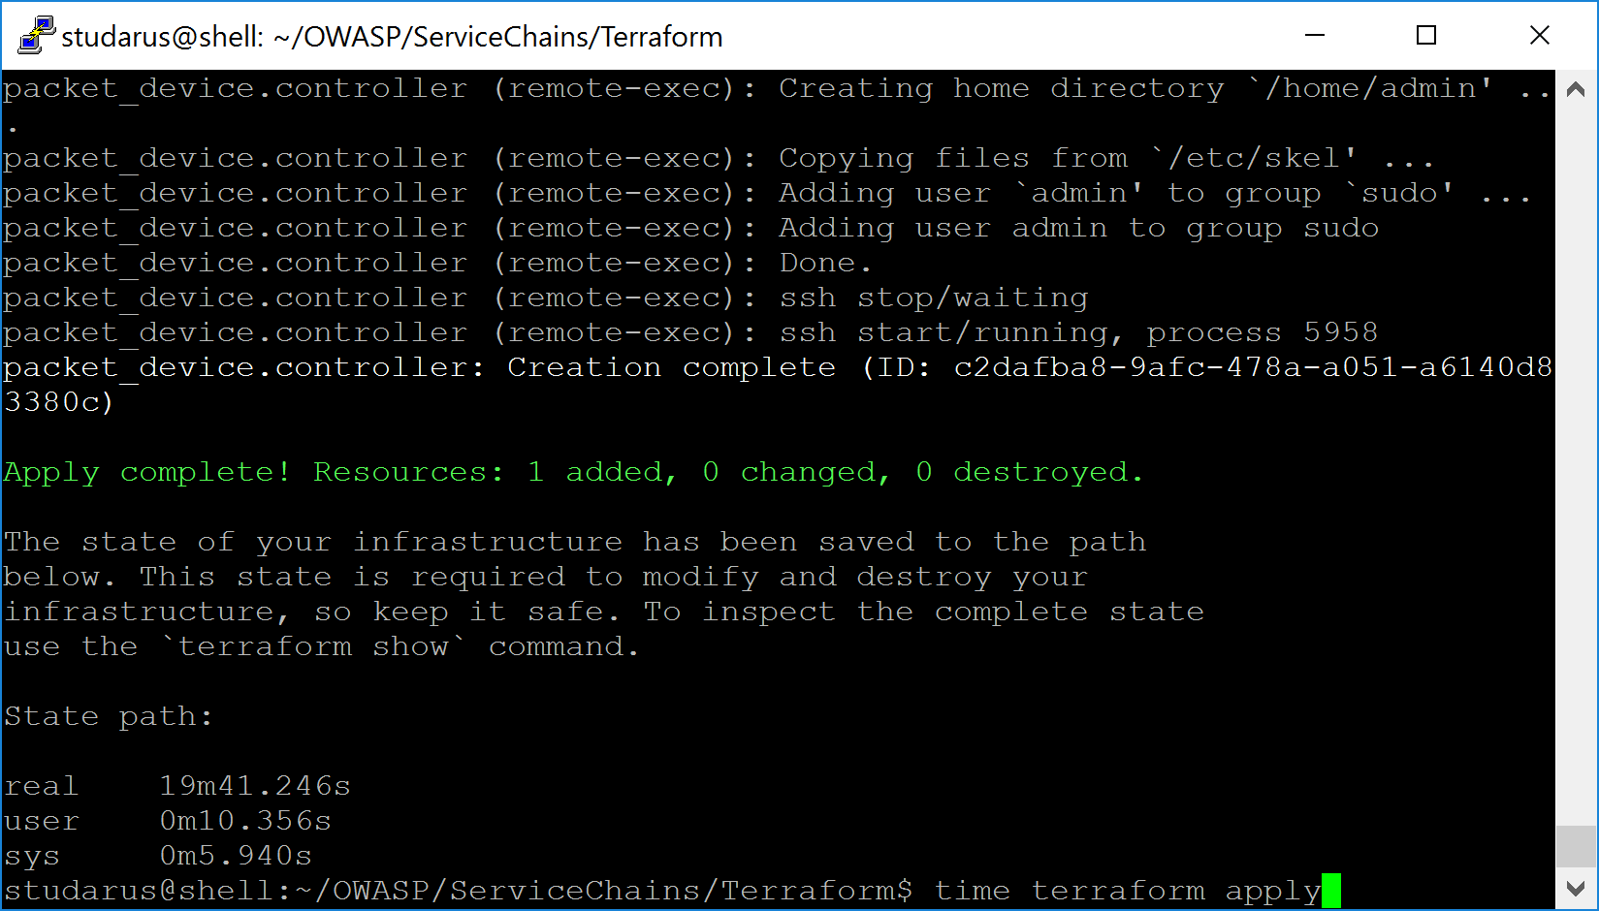
Lab Overview
Terraform Deployment
~20 minutes to deploy
Provisions bare metal
Packet.net account req’d
Hardware
Included in Terraform
Provisioned via Packet API
4 core, 32 GB, 2 x 120GB SSD
2 x 1 Gbps
$0.40/hour
OPENSTACKSD Promo $25/free
OpenStack Deployment
Included in Terraform

Slide 12
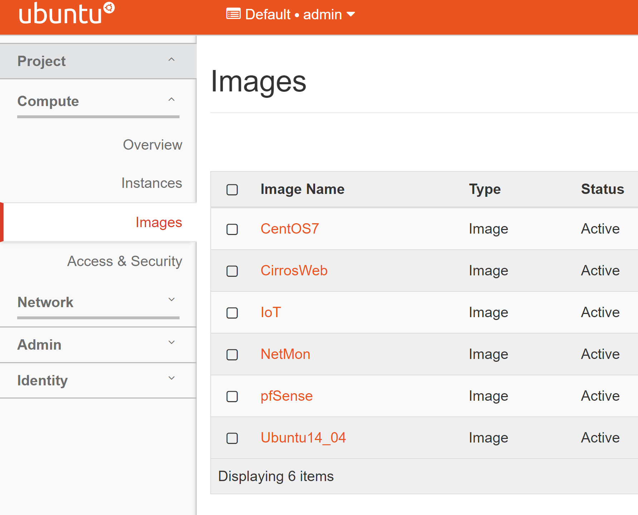
Lab Overview – Virtualized Functions
Stock O.S. Images
CentOS 7
Ubuntu 14.04
Sample Workload
CirrosWeb
Network Monitor VM
Snort
TCPDump
“Malicious” VMs
IoT

Slide 13
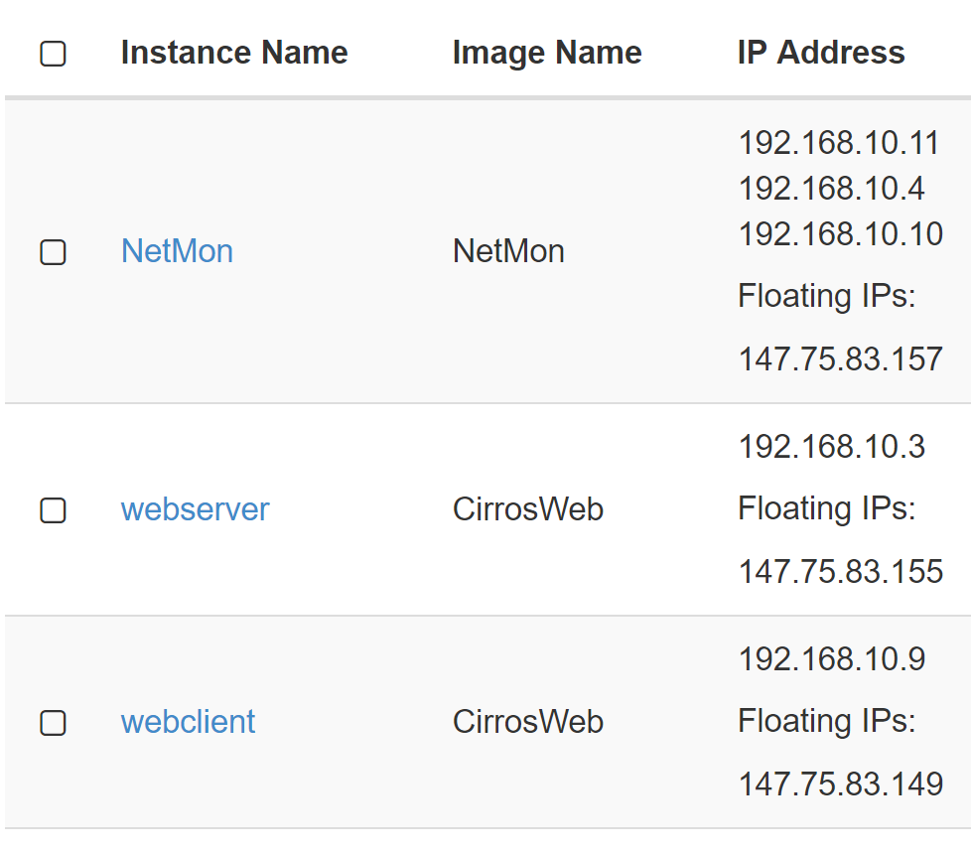
Deployed Workloads and Networks Layer 3 view
Mgmt Network
SSH access
Service Network
Monitoring ports
Internal
Production Traffic
NetMon-{1,2}
Not on internal network
Layer 3 Segmentation

Slide 14
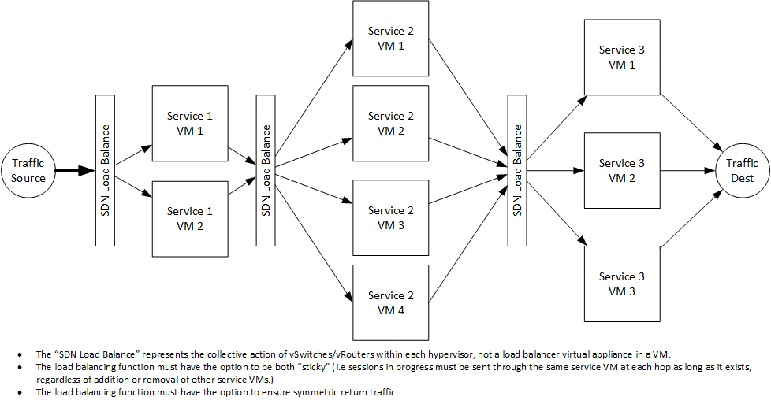
Load Balanced Service Chains
port chain
port pair
port pair group

Slide 15
Lab 0 – Full Demo Setup
Goal
Setup and demonstrate a service chain
Illustrates the end goal of a service chain deployment
Automated setup of all virtual machines, ports, and chains
Requirements:
SSH access to OpenStack Controller
https://github.com/OpenStackSanDiego/SecurityServiceChains/blob/master/Lab0.md
wget https://raw.githubusercontent.com/OpenStackSanDiego/SecurityServiceChains/master/Lab0-create.sh
wget https://raw.githubusercontent.com/OpenStackSanDiego/SecurityServiceChains/master/Lab0-delete.sh

Slide 16
OpenStack Primer
Layer 2 Networking
openstack port list
openstack port show port_name
Layer 3 Networking
openstack network list
openstack subnet list
Virtual Machines
openstack server list
openstack server show server_name
Physical Server/Controller
labX.chains.openstacksandiego.us
172.a.b.c physical address
OpenStack Networking
192.168.a.b/16 virtual network
Physical/Virtual Gateway
Static route within Controller
Allows traffic from Controller into VMs
No external routing

Slide 17
Service Chain Creation
openstack sfc flow classifier create \
--ethertype IPv4 \
--source-ip-prefix ${WEBCLIENT_IP}/32 \
--destination-ip-prefix ${WEBSERVER_IP}/32 \
--protocol tcp \
--destination-port 80:80 \
--logical-source-port port-webclient \
FC-WebServer-HTTP
openstack sfc port pair create --ingress=port-ingress1 --egress=port-egress1 Netmon1-PortPair
openstack sfc port pair group create --port-pair Netmon1-PortPair Netmon-PairGroup
openstack sfc port chain create --port-pair-group Netmon-PairGroup --flow-classifier FC-WebServer-HTTP PC1

Slide 18
Forwarding versus In-Line NFV
Forwarded (TCPDump & Snort-IDS)
passive network monitoring
Inline (Snort-IPS)
active network blocking
tcpdump
Port: ingress (eth1)
Port: egress (eth2)
Port: ingress (eth1)
snort
Port: egress (eth2)
ip route add $WEBCLIENT_IP dev eth1
ip route add $WEBSERVER_IP dev eth2
sysctl -w net.ipv4.ip_forward=1
sysctl -w net.ipv4.ip_forward=0

Slide 19
Lab 1 – My First Chain
Goal:
Monitoring traffic to “Web Server” virtual machine
Deploy a basic service chain
Configure NetMon with tcpdump to monitor traffic
Configure NetMon with snort to monitor traffic
Requirements:
“Web Server” virtual machine
“NetMon” virtual machine
https://github.com/OpenStackSanDiego/SecurityServiceChains/blob/master/Lab1.md

Slide 20
Lab 2 – It Gets Complicated
Goal:
Monitoring and block traffic to “Web Server” virtual machine
Deploy a service chain with two functions (tcpdump and snort)
Configure one NetMon instance with tcpdump to monitor traffic
Configure second NetMon instance with snort to block traffic
Requirements:
“Web Server” virtual machine
“NetMon” virtual machine
https://github.com/OpenStackSanDiego/SecurityServiceChains/blob/master/Lab2.md

Slide 21
Lab 3 – Malicious IoT
Goal:
Deploy service chain to monitoring traffic from black box devices
Deploy service chain to block malicious traffic from black boxes
Utilize the available
Requirements:
“Web Server” virtual machine
“NetMon” virtual machine (tcpdump and snort configs)
“IoT-malicious” virtual machine
https://github.com/OpenStackSanDiego/SecurityServiceChains/blob/master/Lab3.md

Slide 22
Lab 4 – WAF NFV
Goal:
Setup a virtual service function (nginx)
Monitoring traffic at layer 7 using nginx
Deploy using a service chain
Requirements:
“Web Server” virtual machine
“NetMon” virtual machines
https://github.com/OpenStackSanDiego/SecurityServiceChains/blob/master/Lab4.md

Slide 23
net-sfc setup…
# install the port security extension so that port security can be turned on/off per network/por
# service chaining requires port security turned off
crudini --set --list /etc/neutron/plugins/ml2/ml2_conf.ini ml2 extension_drivers port_security
# install and configure networing-sfc
yum install -y python-networking-sfc
# enable the service plugin (controller nodes)
crudini --set --list /etc/neutron/neutron.conf DEFAULT service_plugins networking_sfc.services.flowclassifier.plugin.FlowClassifierPlugin
crudini --set --list /etc/neutron/neutron.conf DEFAULT service_plugins networking_sfc.services.sfc.plugin.SfcPlugin
# port security needs to be off for service chains
openstack network set --disable-port-security $NETWORK_ID

Slide 24
Setting up your own lab
Requirements:
Packet & DNSimple Accounts
Software: git, terraform
Steps
git clone https://github.com/OpenStackSanDiego/SecurityServiceChains
ssh-keygen –f packet-key
Create Packet account/project with key
Setup Packet & DNS keys in vars.tf
terraform init
terraform apply

Slide 25
Next steps…
Sophisticated chains
OWASP Top 10 – Web Apps
Database Security Service Chains
networking-sfc plugin
Load Balancing Support (“Port-Pair-Group”)
Better flow classification filters
Rest API Support
Move towards dynamic allocation of security controls at workload deployment
NFV in Containers
Lighter weight security implementations
Ability to overlay configs on top of base containers

Slide 26
Thanks!

